Slide 1

MIDTERM PROJECT PROPOSAL
TODAY'S DATE: 10/2/2023
HUNG TRUONG

Slide 2
Professional Portfolio Website
To showcase all my skills, relevant experience, and etc.
Enable to attach all crucial documents onto 1 platform,
- Ease of navigation for recruiters while trying to get to know me as an applicant

Slide 3
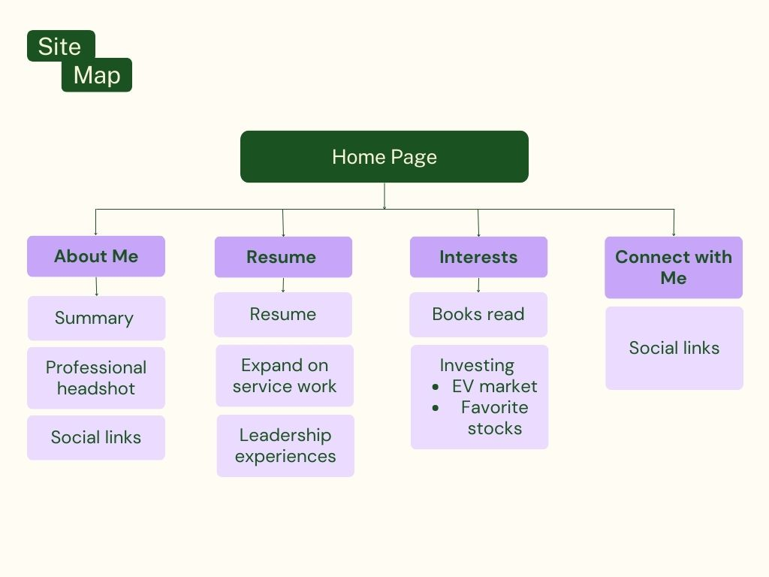
Site Map

Slide 4
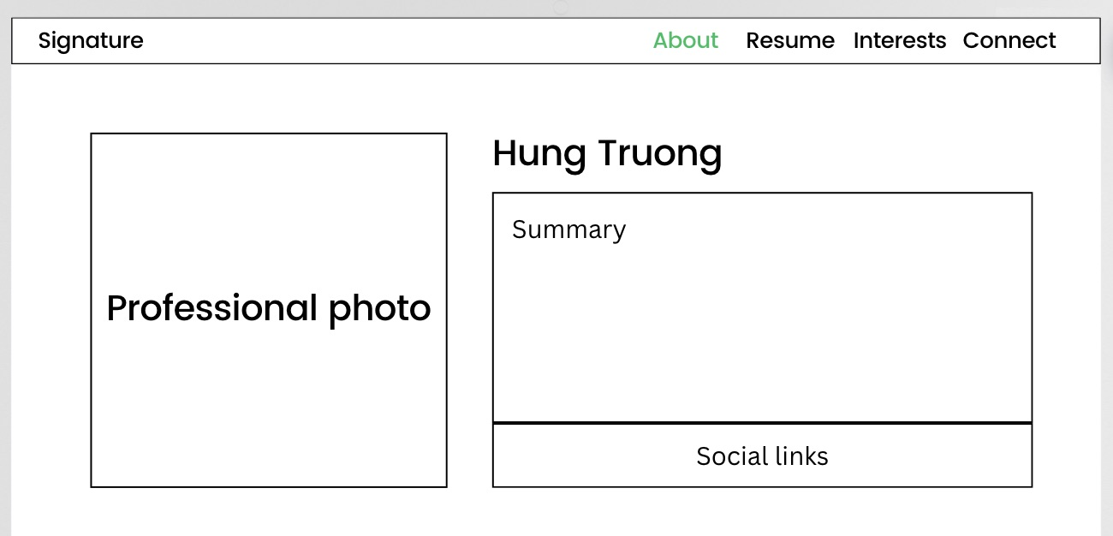
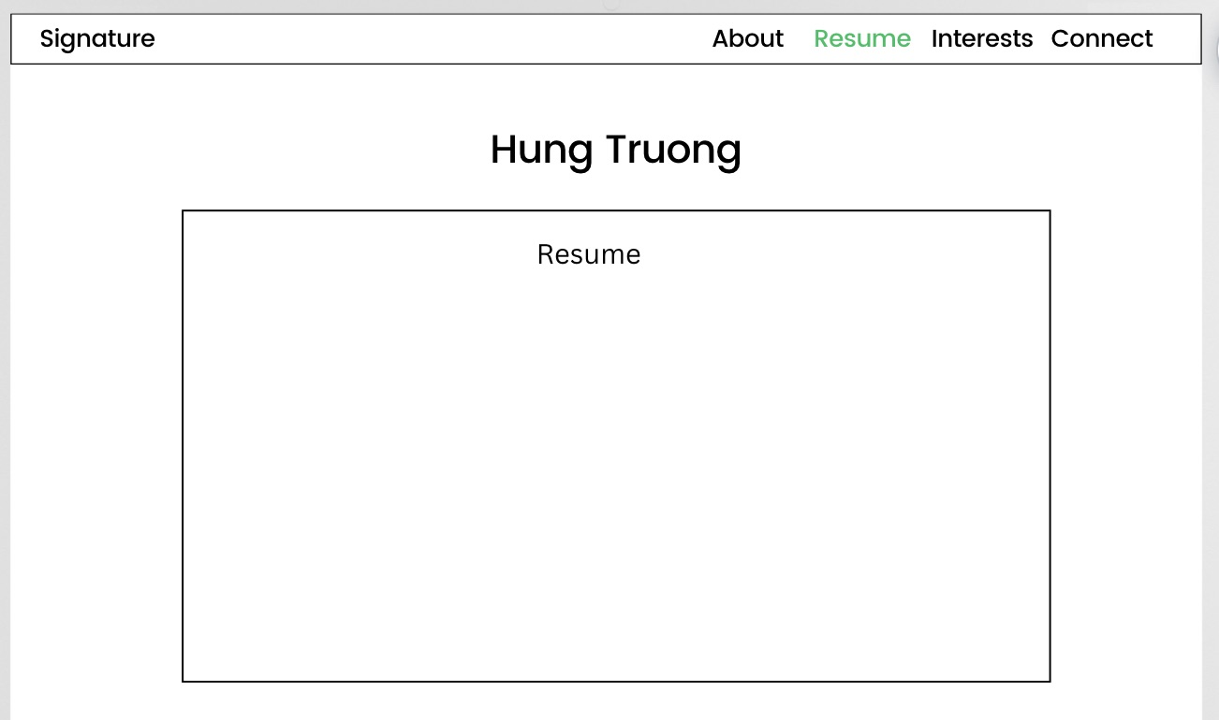
Wireframes

Slide 5
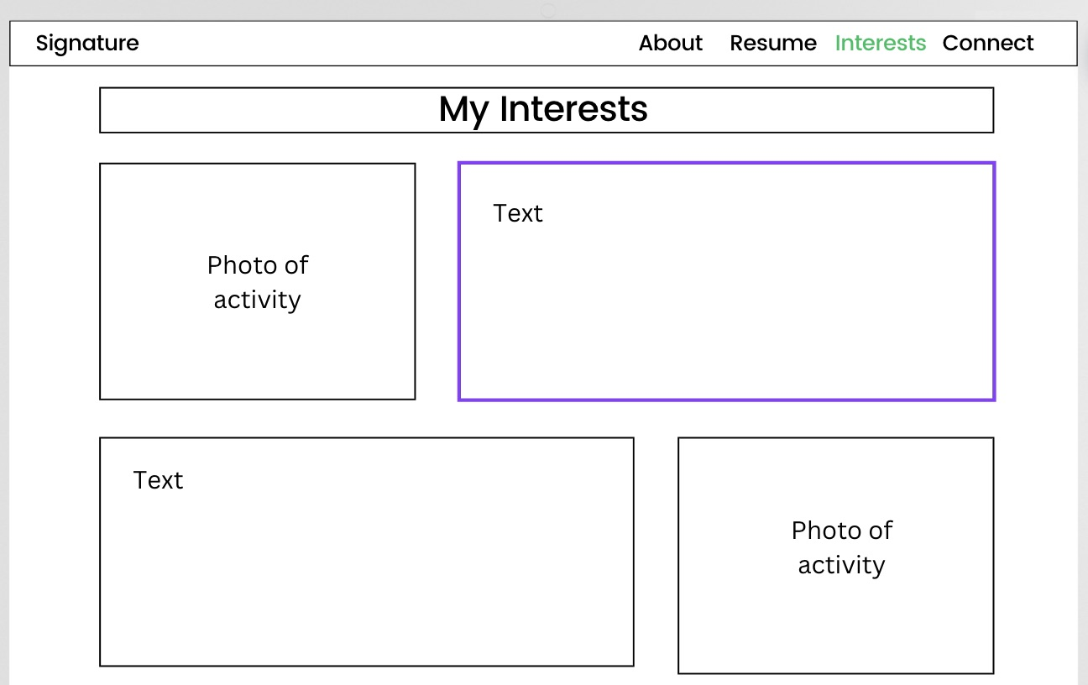
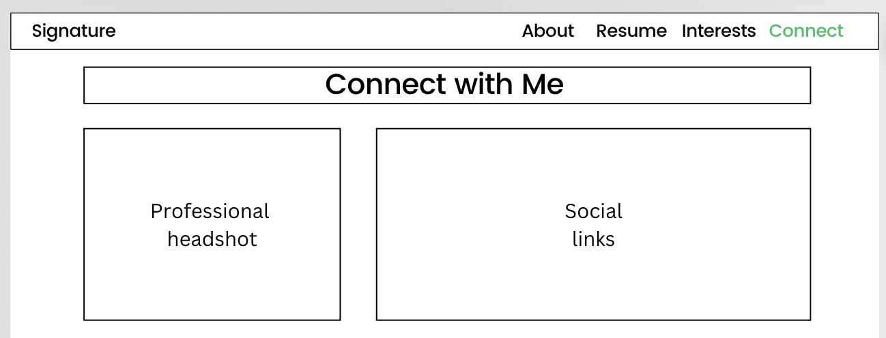
Wireframes (cont.)

Slide 6
Inspirations
Some websites I drew inspirations from:
https://pascalvangemert.nl/ (full-stack developer from Netherlands)
https://garyvaynerchuk.com/ (famous American entrepreneur)
https://www.ariannahuffington.com/ (founder of The Huffington Post)
Pinterest mood board: https://pin.it/3l3UTZu

Slide 7
Concepts
Have learnt
Need to learn
Nav bar
Flexbox
Header
Divs
Font imports
Animations when clicking on subpages
Certain content only show on scroll
Slideshow images
Dynamic button (click-to-top)

Slide 8

Thank you!

